Slide 1
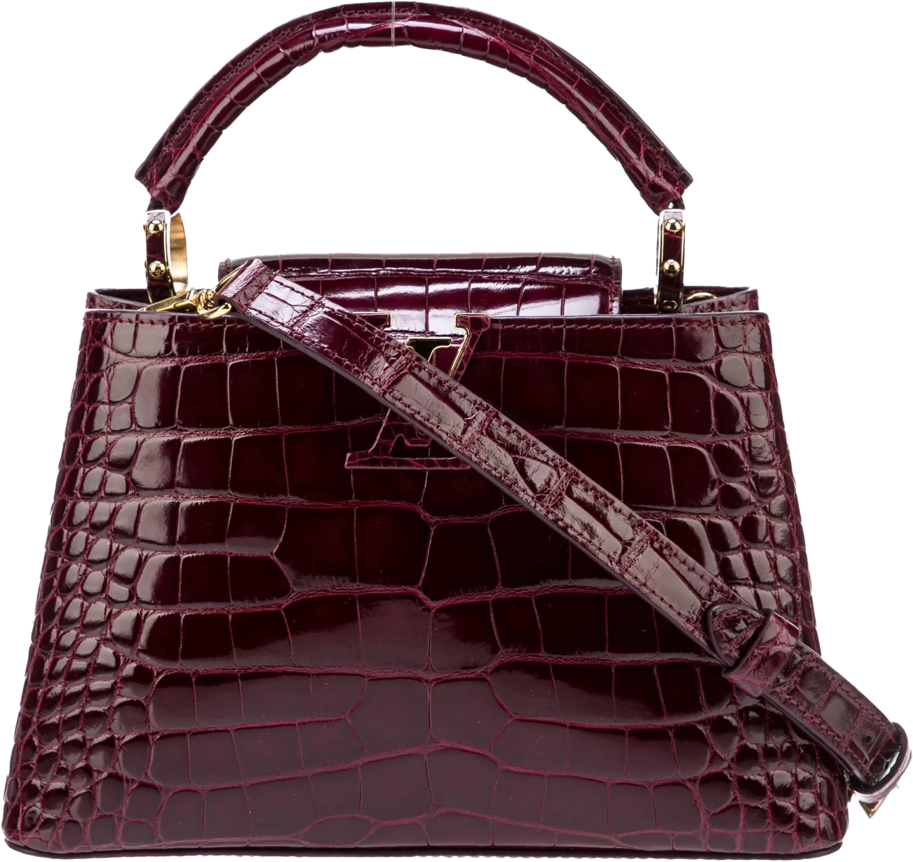
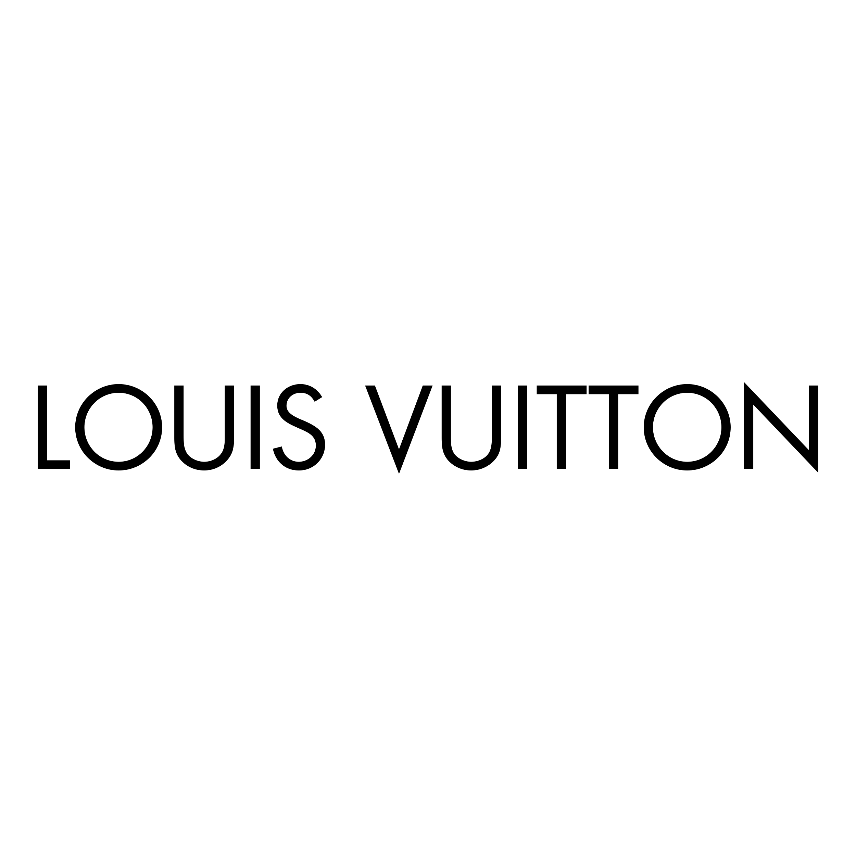
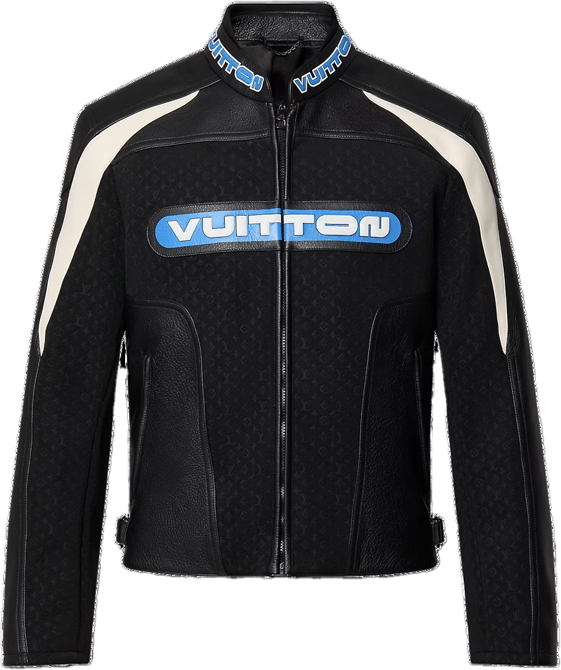
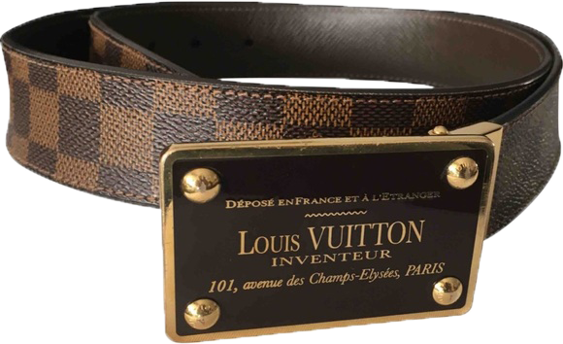
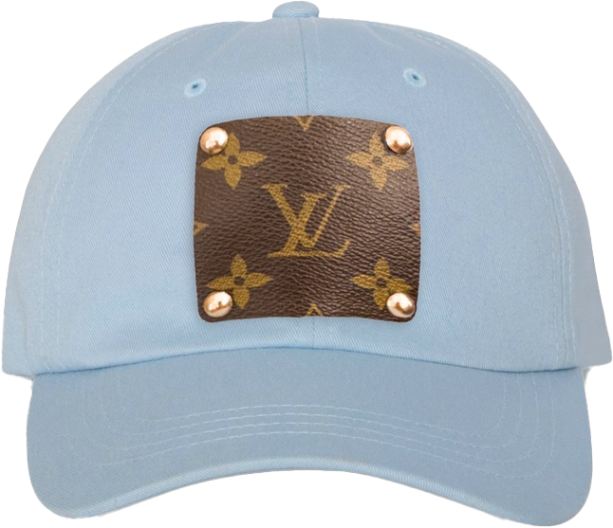
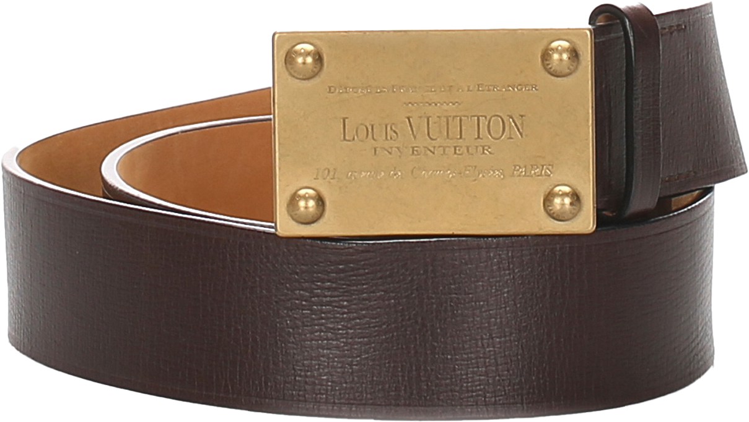
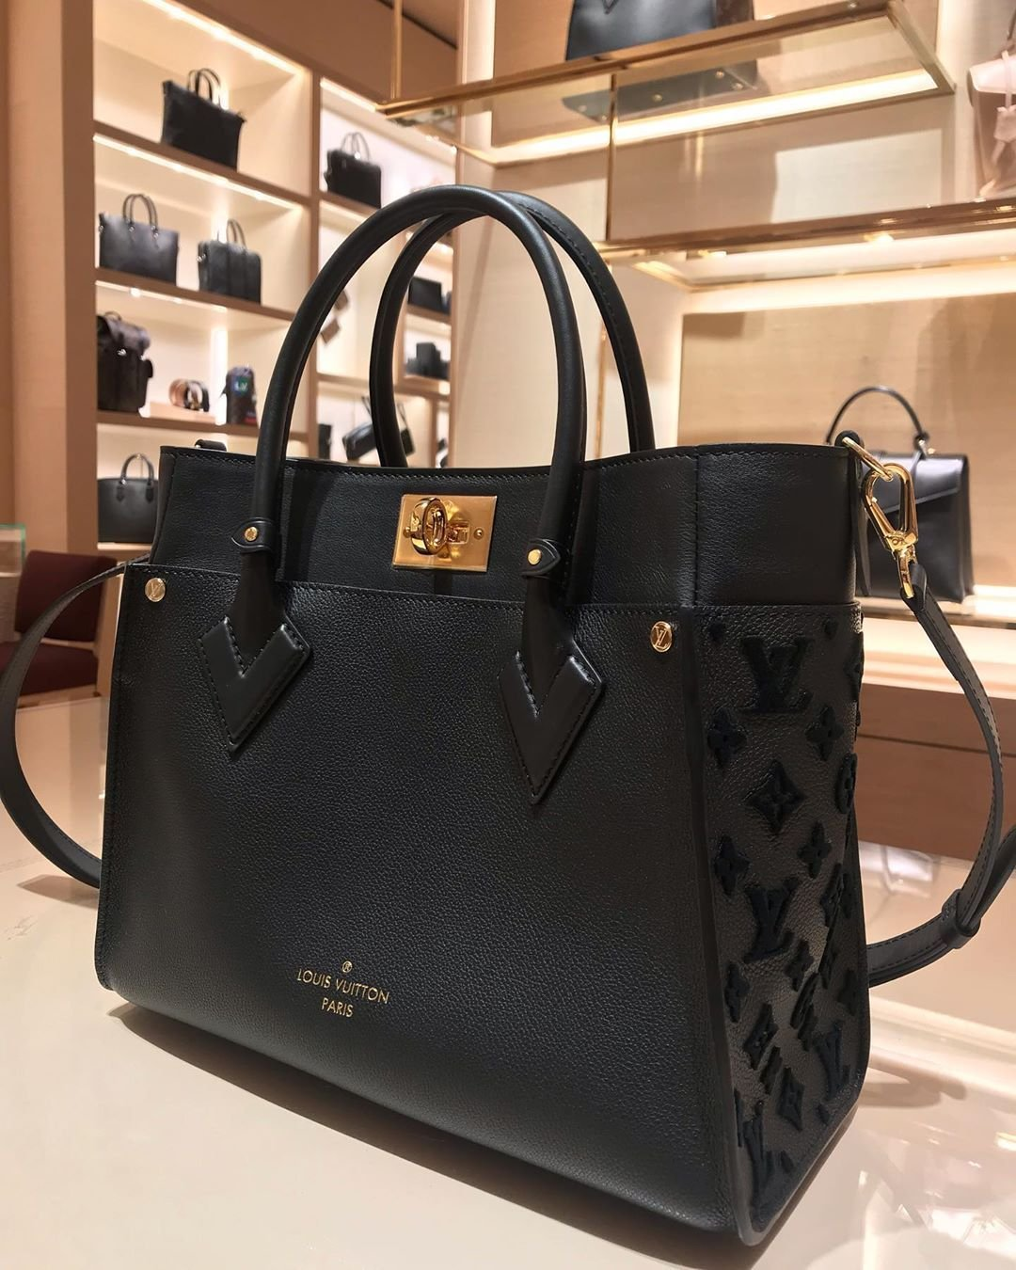
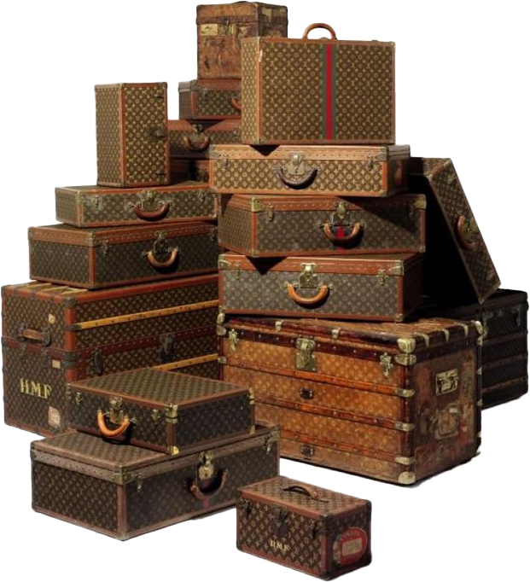
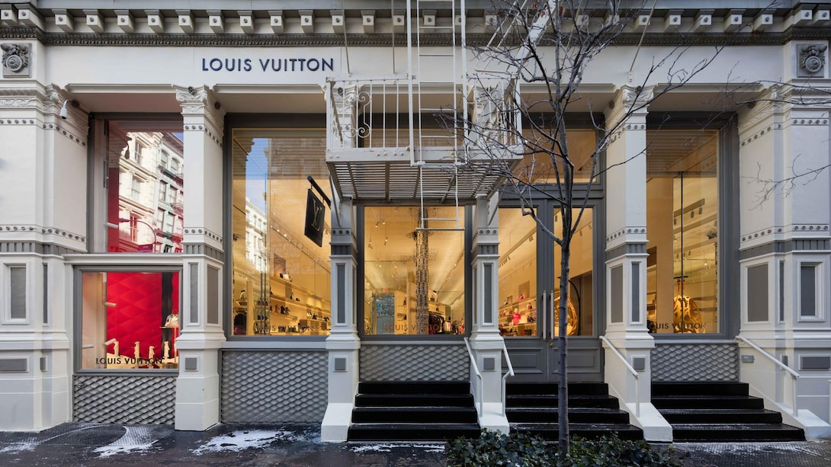
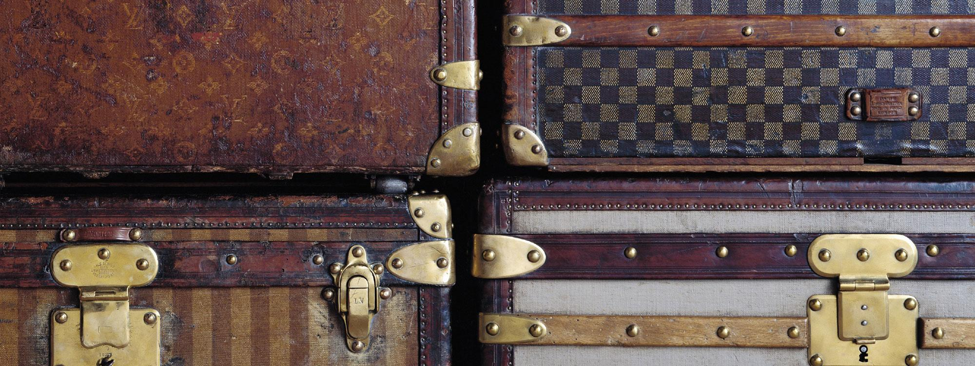
LEATHER GOODS
By Audrey Prater

Slide 2
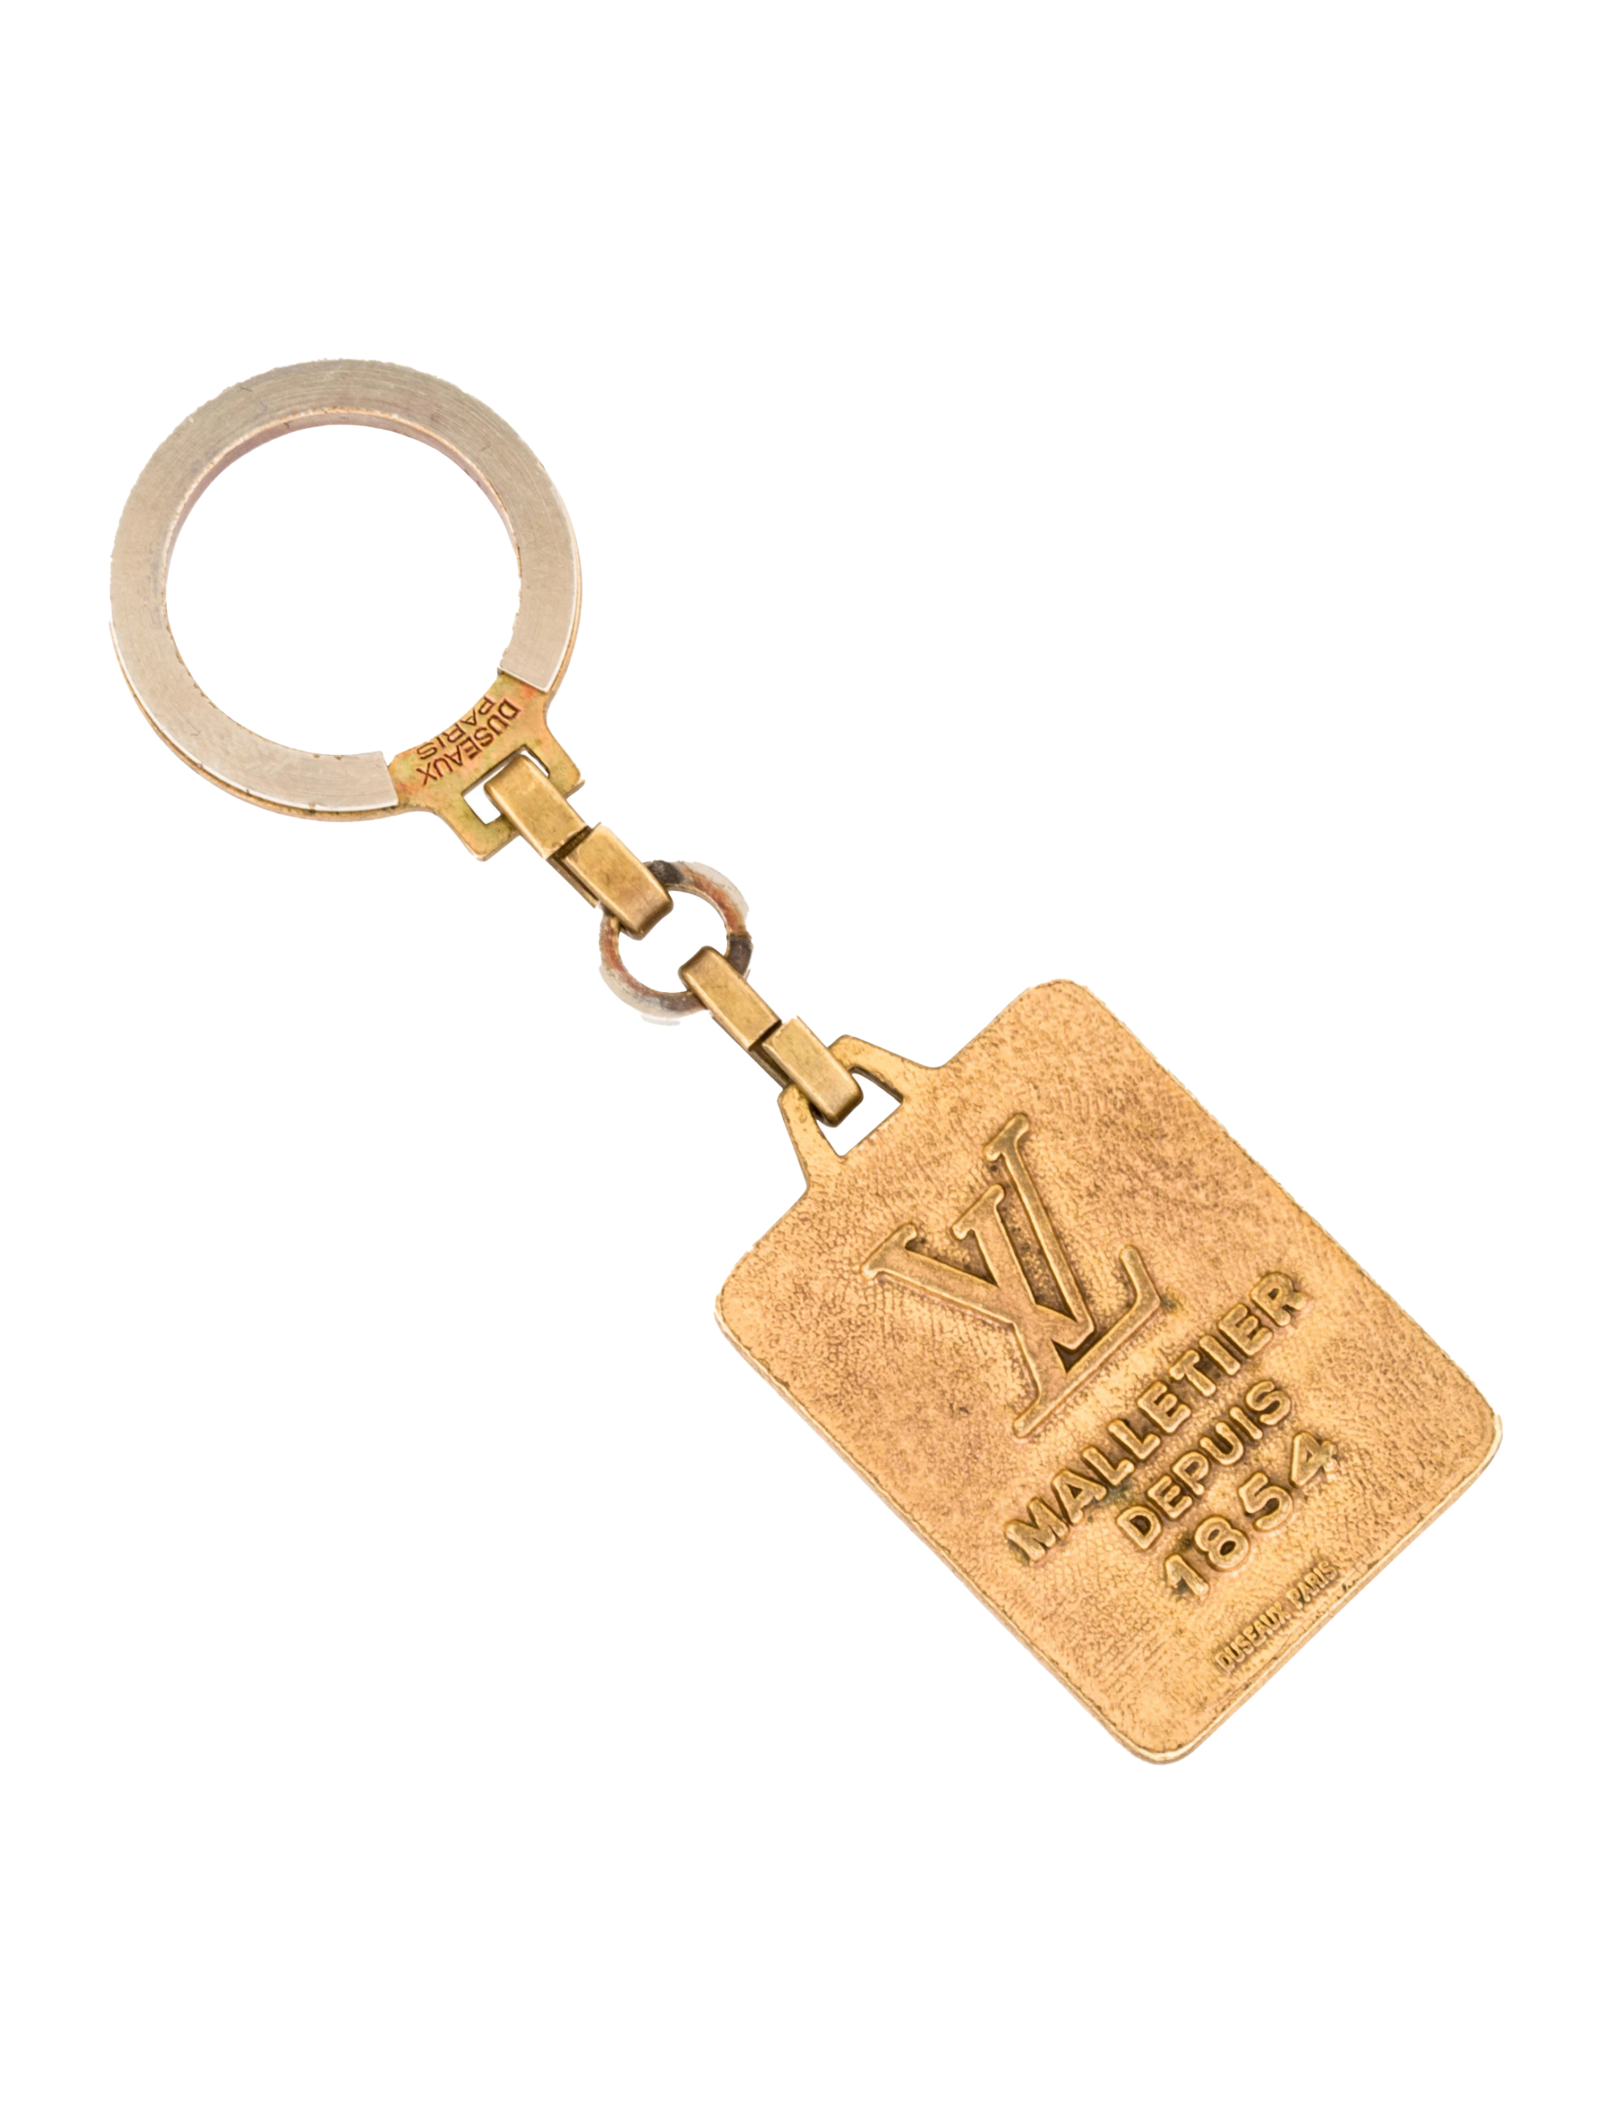
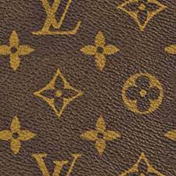
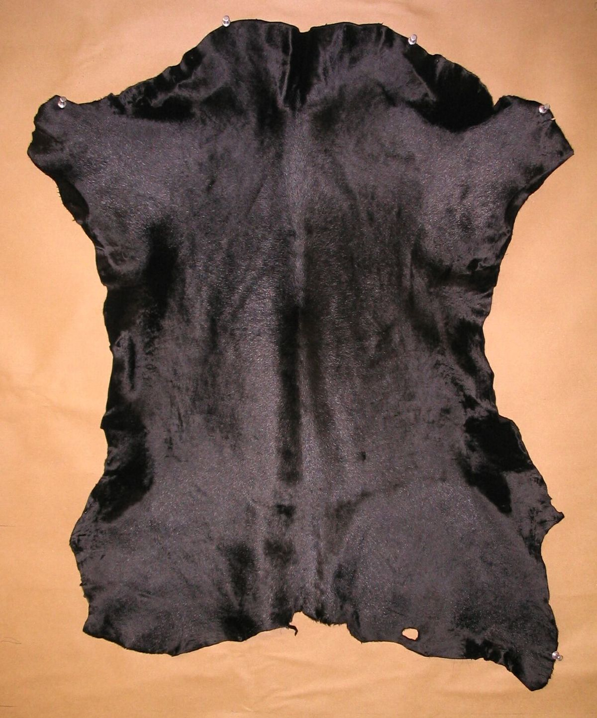
Executive summary
OPTIONS: textured leather, embossed leather, and calfskin leather
SOURCED: France, Spain, Italy, and the United States
CRAFTSMANSHIP: highest quality; soft, but durable effect
ROOM FOR IMPROVEMENT: Gaps between 5 specific target markets and Louis Vuitton, offering room to connect with consumers on a more personal level.
Notes:
Louis Vuitton has been established since 1854, and they offer many different types of leather, catering to a wide demographic of people with different wants and needs.
They have textured leather, which is course grain. This leather is very durable, and is evident in much of their tote bags. It may be handled roughly.
Embossed leather allows for many designs and prints with the application of heat and pressure. This can give a crocodile or ostrich appearance.
Calfskin leather, then, is lighter and more supple, and is made from older cows. This allows for a more delicate design, often seen in smaller accessories for a night out.
They source leather from France, Spain, Italy, and the United States.
The craftsmanship is elite, of the highest quality by the most talented craftsmen. This is their Value Proposition.
FUN FACT:
It usually takes 8 days and between 20 to 30 craftsmen to produce a “Reade” tote bag.
Their Neverfull bag takes about 45 hours.
Still: There is room for improvement between 5 specific target markets and LV, offering room to connect with consumers on a more personal, and profitable, level.

Slide 3
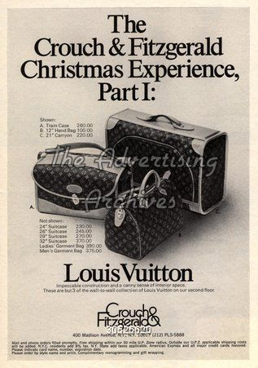
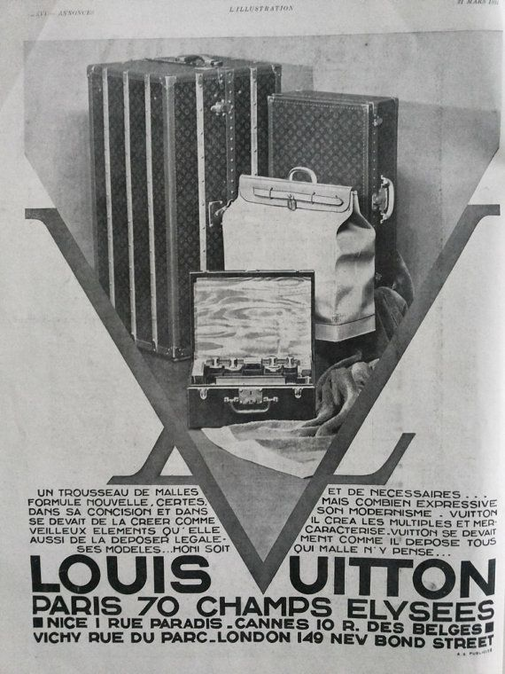
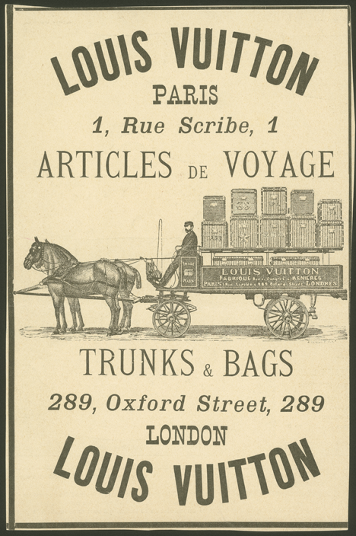
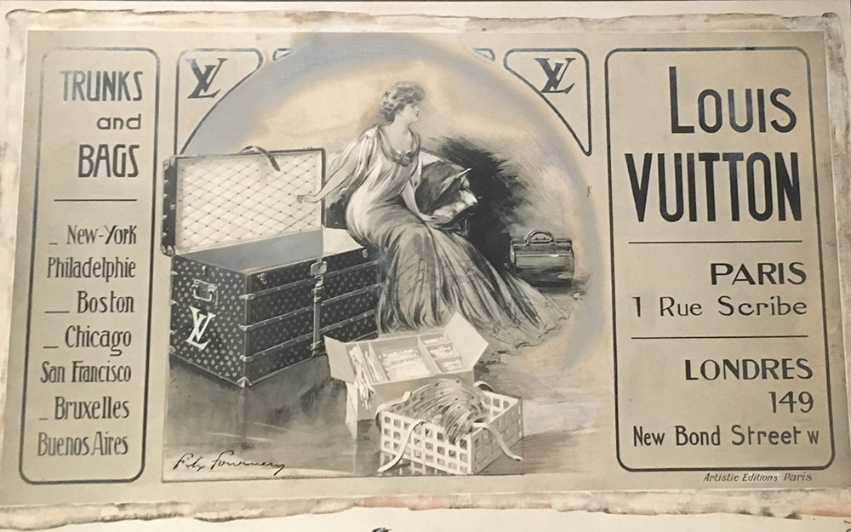
LV Leather Ads Then:
Notes:
1800 advertisements from LV.
Louis started with luggage as his first product offering, specifically the steamer trunk.

Slide 4
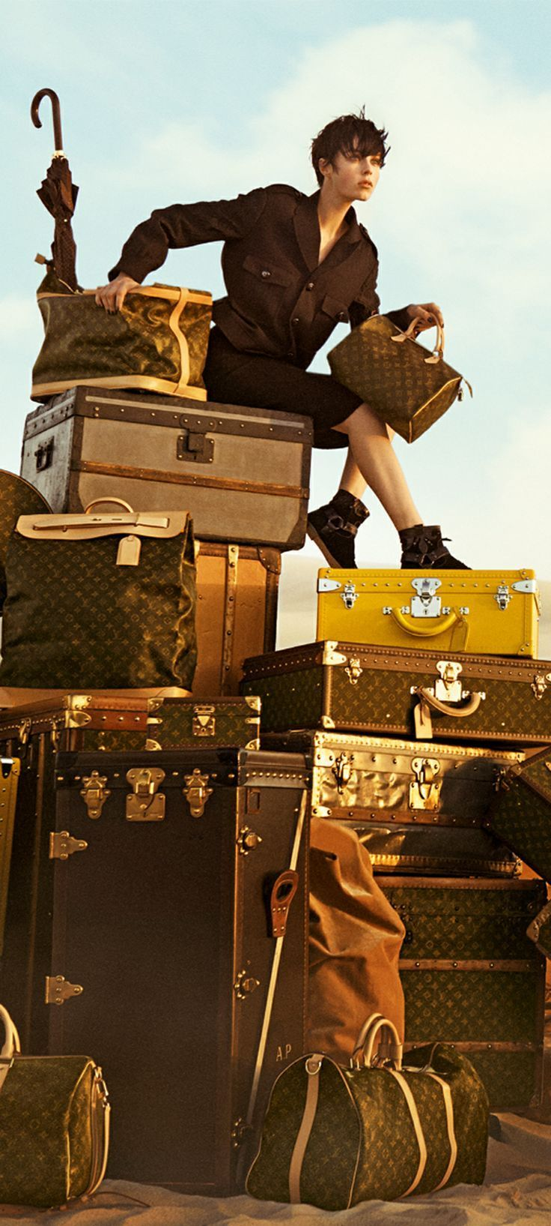
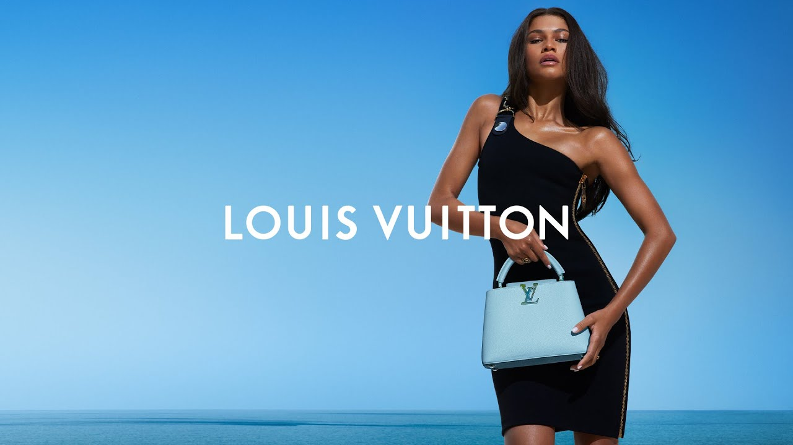
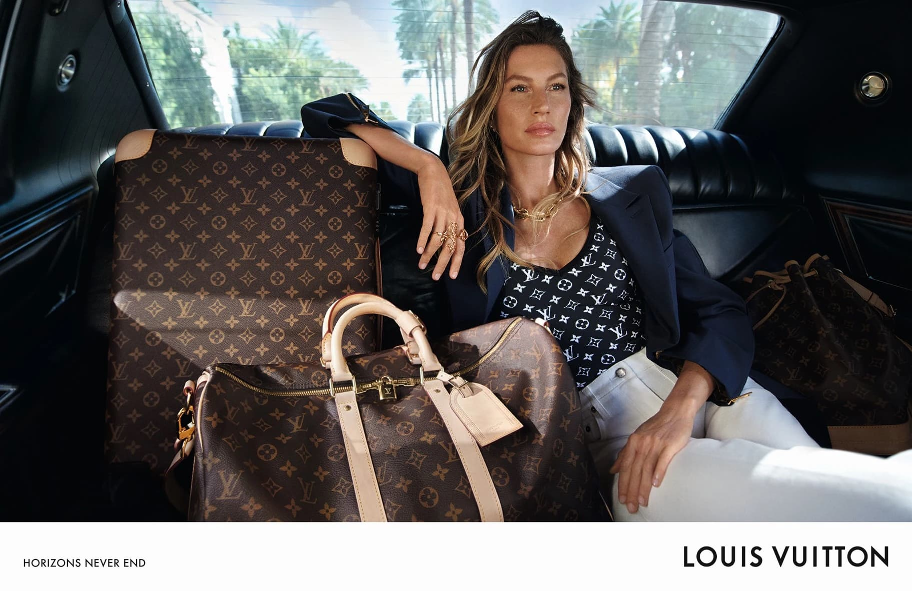
LV Leather Ads Now:
Notes:
Above are a multitude of LV leather ads, commonly alluding to the journey.
The journey is the intrinsic message behind LV leather goods.
What is the journey?
LV defines it as : "a journey that requires all of us to question everything we do and how we do it, to constantly improve and go further. That's the journey we are on since 1854."
These ads show how they cater to a multitude of needs and target markets.

Slide 5
Target Market | Values
“Gen Z” (Teens, Young Adults; 18-25) | Interaction / Community; Environment / Sustainability
Early Adopter Women (30-50) | Education; Information; Credibility; Quality; Status
Celebrities & Influencers | Collaboration Opportunities; Exclusive Products; Monetary Compensation / Perks
Young Professionals | Elegance / Sophistication; Exclusivity / Status
Fashion-Forward Individuals | Trendsetting / Innovation; Engagement with Fashion Community; Distinctive Style / Self-Expression
Notes:
*** Talk about what is important / valuable to each ***
Gen Z:
***This specific age group of Gen Z: 18-25
Considered the "movers and shakers", commonly called trendsetters --> LV can look to them for the next moves / trends / styles
They value personal interaction with brands– very community-driven
Care immensely about environment and eco-friendly causes --> sustainability-driven
*** VERY IMPORTANT DEMOGRAPHIC: may not have money / resources now, but they will in the near future. Their opinions matter
Early Adopter Women 30-50:
usually upper class; many have traditional family values
high-involved consumers
Know a lot of quality; the sourcing of the leather will be important to them
Very educated
Value gatekeeper's opinions for reinforcement and credibility: such as editors of fashion magazines, and experts and influencers like Serena Williams and Amal Clooney
They are not silent on social media, either.
24% of all Instagram users fall within the age of 35-54, and they have the most money to spend, most of which fall under the “mass market”.
Young professionals
Most likely the first time in their life they are receiving a high steady income. They want to purchase something that would be their "everyday" staple work bag. Which means they are looking for something that looks very sophisticated for the work place and high quality that will last a long time.
As they enter their professional careers, an LV product shows a symbol of high status.
Young professionals entering the job market often aspire to elevate their status. Owning luxury items like those from Louis Vuitton can show achievement and success, granting them a sense of exclusivity and pride.
Celebrities & Influencers
Always seeking for collaborations. Partnering with Louis Vuitton elevates the public image and perceived status of celebrities and influencers. Being associated with a prestigious luxury brand like LV signals success, sophistication, and a refined sense of style to their audience.
Celebrities and influencers often receive access to LV's exclusive or limited-edition collections, allowing them to showcase rare and unique items that are not widely available. This exclusivity adds to their appeal and distinguishes their style.
celebrities and influencers might receive monetary compensation, free products, or other perks from Louis Vuitton in exchange for promoting the brand. This can include access to events, custom-designed items, or endorsements.
Fashion- forward individuals
Fashion-forward individuals seek innovation and trends that push boundaries.
LV is known for its collaborations with popular artists and designers, they introduce innovative materials, and styles. This appeals to consumers who want to stay ahead in the fashion world.
These individuals value self-expression through fashion. LV unique designs and iconic pieces allow them to make a statement and showcase their distinctive style. The brand offers a diverse range of products, from classic to unique, which allows consumers to find items that resonate with their personal fashion style.

Slide 6
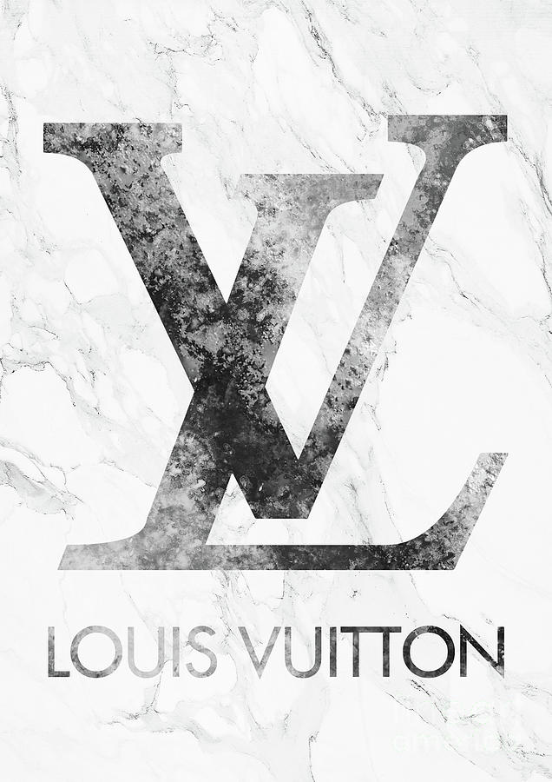
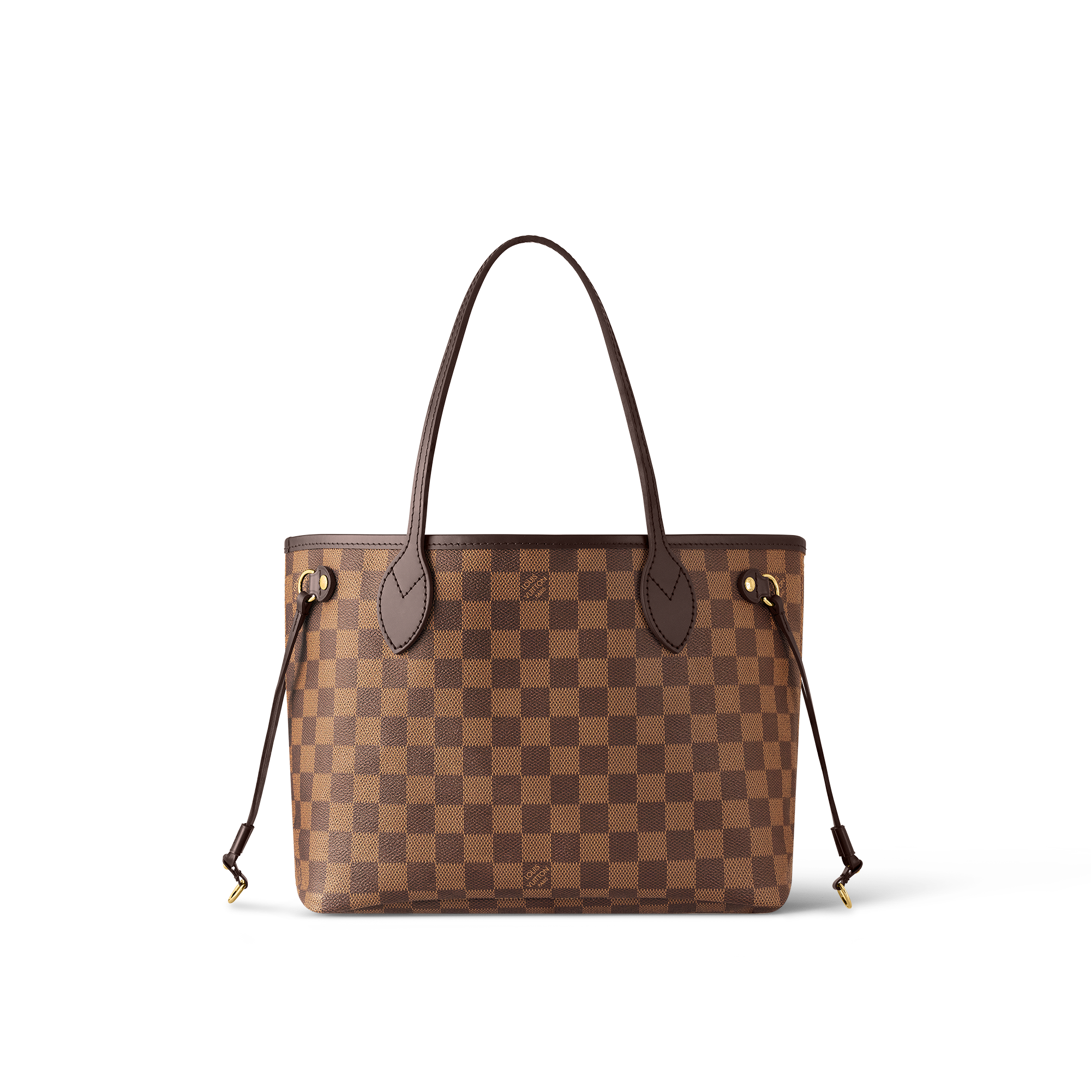
Target Market | Gap
"Gen Z" (Teens, Young Adults; 18-25) | Digital Media Hype
 | Eco-Friendly: Deadstock Leather & Vegan Leather Options
 | Price
Early Adopter Women (30-50) | Exclusivity: Needs an Exclusive Image
 | Secondhand Value
LEATHER GOODS
Notes:
Gen Z Gaps:
LV needs to create more hype on social media
gaming systems, social media contests, or even an interactive website
Price gap: Desiring trendy products that are considered in-style, a gap is prevalent between the price for a durable Louis Vuitton versus the price of something that is hot only for a season.
Promote their sustainability efforts *** the journey
This demographic is very dismayed about climate issues, offering Louis Vuitton an opportunity to promote their use of deadstock leather and vegan leather options.
Because this segment loves thrifting and vintage items, Louis Vuitton could make use of deadstock leather, and revamp old styles for the new “kids”.
The brand has aspirations to meet new sustainability expectations by 2025. They should have campaigns centered around this central theme idea to resonate with younger consumers, and show a sign of good will to make better, more responsible changes for the future.
Early Adopter Women Gaps:
This segment does not value trends! They value status, which comes with exclusivity.
When bags such as the LV Canvas bag become common, this segment loses interest immediately. Some have said LV is in danger of "becoming the next iPhone". That is, so many have it, it has lost its appeal.
The brand perception has been hurt by too many of these bags becoming available.
This demographic is not afraid to shop secondhand, on places like the real real. Because they seek value, LV needs to create new styles that are not repetitive of old ones.
Many shoppers feel there is no reason to buy brand new, when the styles are remaining somewhat of the same. Innovation is needed.

Slide 7
Target Market | Gaps
Celebrities/Influencers | Products Too Easily Accessible
 | Affordable Pricing
Young Professionals | Budget
 | Overexposure
Fashion-Forward Individuals | Trends/Innovation
 | Minimal Presence on Major Fashion Sites
LEATHER GOODS
Notes:
Celebrities and influencers:
Making products harder to purchase (not as readily available in stores or online)
Increasing prices on select bags to generate more hype
-Louis Vuitton handbags range from around $1,100 to about $6,000.
hermes makes birkin bags that have a waiting list to purchase and the prices can go from 10,000k to over 400,000k.
Young working people/upper- class adults: this target market have limited options because of their budget limitations since they are a part of the younger demographic. They may not be able to afford the more expensive leather.
Overexposure: The brand is competing in a very saturated market. Overexposure of LV bags may discourage this demographic from spending their first big paycheck at LV. There are a multitude of counterfeit options that has hurt brand perception. Other bags may seem more "desirable" for what this target market is seeking.
Fashion Forward Individuals:
Trends / Innovation: As said, LV can get somewhat repetitive with their offerings. Those who are fashion forward are seeking something innovative, that is new from the norm, rather than the standard, traditional LV bag. Fast fashion brands are on the rise and constantly producing items that are trendy. LV is sticks to their classic style and is very slow in terms of putting out new designs.
Minimal Presence on Major Fashion Sites: This demographic places major emphasis on social trends and hype, as they want to be ahead of the curve. Promoting LV on Pinterest and Locker will help it mark its spot as a "must-have" product that is popular with the trendsetters.

Slide 8
Highest Priority Gaps | Recommendations
Digital Media Hype "Gen Z" Teens, Young Adults (18-25) | Gaming Systems; Social Media – Pinterest & Locker; Central Message & Theme of Sustainability & the Journey
Minimal Presence on Major Fashion Sites Fashion-Forward Individuals
Sustainability "Gen Z" Teens, Young Adults (18-25) | Reposition and revamp old products to be fresh, new, and sustainable for an adjusted price to reflect the deadstock leather.
Secondhand Early Adopter Women (30-50)
Budget Limit Young Professionals/Young Upper Class (23-35) | Leather alternatives provided; cowhide leather, vegan leather
Overexposure Young Professionals | Release a highly-exclusive, highly-desired bag with a very steep price. Generate interest for the bags by dressing sought-after influencers and celebrities but keeping it from the public.
Exclusivity: Needs an Exclusive Image Early Adopter Women
Notes:
Gen Z Digital Media Hype Recommendation:
This demographic and gap was chosen because the Gen Z segment is highly influential and they offer a special need to increase popularity among LV's sought-after products.
We were also able to incorporate the gap with fashion-forward individuals, to kill two birds with one stone.
Establish a community in a digital space. This will be done by conventional social media channels like Instagram, TikTok, Facebook, and Pinterest. Pinterest in immensely valuable, as it generates interest with the trendsetters, Louis Vuitton is lacking drastically in this space. Pinterest also has the highest level of income among users in comparison to other platforms. When searching for LV styles on Pinterest, they were hard to find. Locker is a very important app as well where stylists link their styles and generate hype among the fashion community. However, they also would benefit greatly from stepping in to the gaming atmosphere. With VR and AR offering new angles into the shopping space, Louis Vuitton would be ahead of the game if they not only advertised on gaming systems and platforms, but offered interactive methods with it. For example, gamers can dress their avatars with new LV leather accessories when they make an accomplishment in the game.
These ads should also be heavily reinforcing the idea of sustainability, and how it goes hand in hand with their central message: the Journey.
The Sustainability & Secondhand Gaps experienced by the Gen Z and Early Adopter women can be remedied with 1 Recommendation:
Two birds can be killed with one stone here, making these two gaps extremely attractive to target.
The early adopter women, again, are apart of the mass market, with the most money to spend. They must be taken into account.
Be ahead of the curve. Make use of all old deadstock leather and revamp these products. Gen Z in particular is loving vintage styles, so this will interest them. Furthermore, it adds value right at Louis Vuitton that secondhand retailers such as The Real Real cannot easily replicate.
Give these new, revamped bags new functions for the modern women with many demands. This will keep the value lying in the new products, swaying the intelligent consumers away from price-attractive secondhand retail websites.
Budget Limit for Young professionals:
Recommendations would be to opt in for the more affordable leather, such as cowhide leather or calf leather, which are much more affordable options compared to croc leather.
Since this demographic is just starting out in their designer journey, they can benefit their budget limit by limiting the amount of products they buy, this demographic generally purchases designer bags, so they can budget according to that.
Overexposure for young professionals & exclusivity for early adopter women:
Again, two birds one stone
Release a highly exclusive bag that generates conversation, desire, and hype. Make it very exclusive, similar to the Birkin bags. Dress up experts, influencers, and relevant celebrities, but

Slide 9
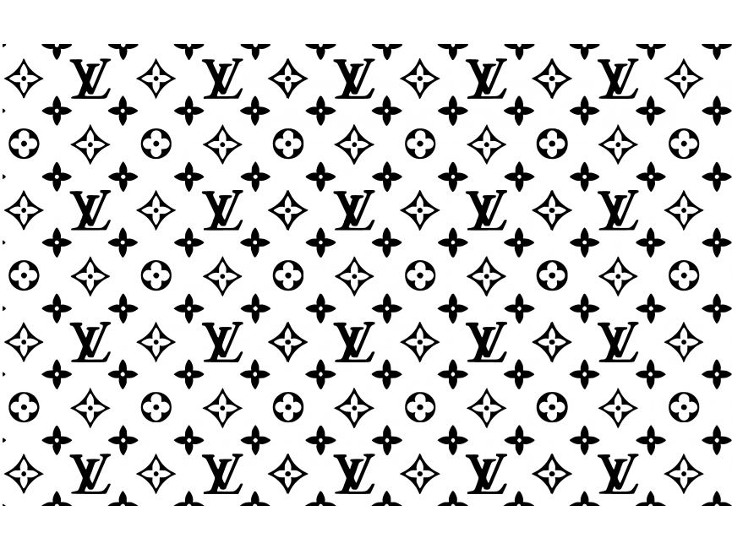
Conclusion
THANK YOU!
THANK YOU!
Notes:
These 5 target markets were chosen because of their overall impact on the market and generating interest among the fashion community. These 5 target market's values play a tremendous role in the success of Louis Vuitton.
These groups are experiencing different gaps that were able to be solved with a singular solution.
Louis Vuitton is a timeless brand, offering a wide range of products that are unique and cannot be found everywhere, making it stand out from other brands, with our recommendations, the brand can become more successful and appeal to the younger generations moving forward.

