Slide 17
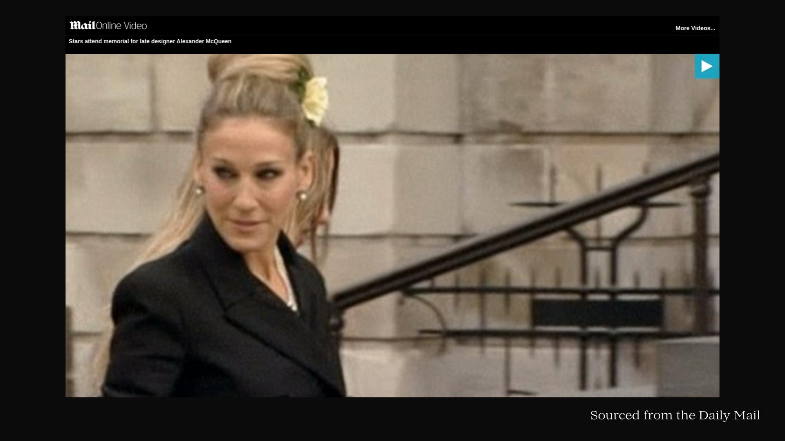

Slide 21
Thank You!

